Slide 1

Model Learning
Matthew Engelhard
Notes:
Hi Everyone
In previous lectures, we’ve talked about models, their parameters, and the idea that we want to tune those parameters to those values that give us the best predictions on the training set
But we haven’t talked about how that tuning takes place, or what we even mean by the “best” values of our parameters
In this lecture, we’ll define what we mean by “best”
And we’ll start building some intuition around how that tuning process takes place
By the end of the lecture, you should know what is meant by the loss associated with a particular model
You should also understand the specific loss used for binary classification problems – called the cross-entropy loss – and with some practice, you should be able to calculate it if you’re given model-predicted probabilities and the associated binary labels
And finally, you should be able to describe, from an intuitive perspective, how model parameters are typically tuned in machine learning

Slide 2

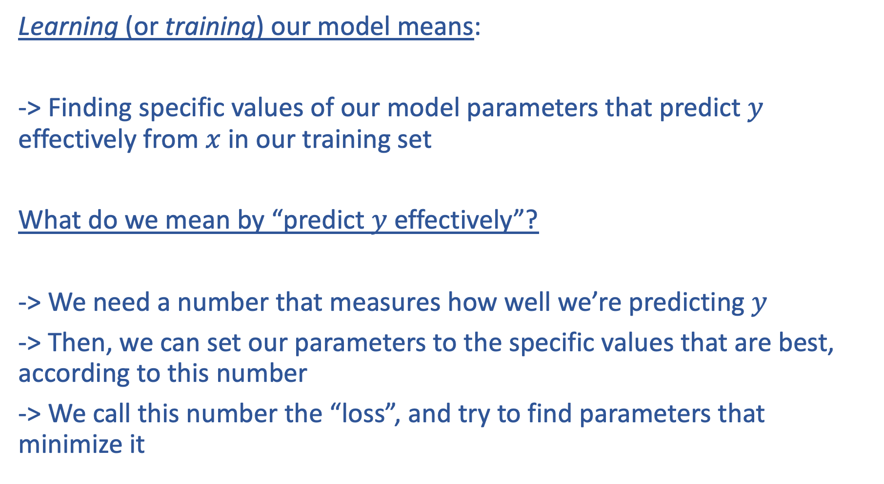
Learning (or training) our model means:
-> Finding specific values of our model parameters that predict $y$ effectively from $x$ in our training set
What do we mean by “predict $y$ effectively”?
-> We need a number that measures how well we’re predicting $y$
-> Then, we can set our parameters to the specific values that are best, according to this number
-> We call this number the “loss”, and try to find parameters that minimize it
Notes:
Now, the name of the field is machine learning
And so far, we’ve talked a lot about the machine in machine learning – this is the algorithm or equation that links features x to outcomes y
But we’ve talked much less about the learning in machine learning. We know that our machine – our model – it contains parameters that can be adjusted to make sure its predictions for a given x are close to the true value of y
And by learning, what we mean is taking a training set, looking at pairs of x-es and ys contained in it, and setting the parameters to the values that predict the x’s best based on the y’s.
But then, the natural thing to ask is, what do we mean by best? That’s the main question we’ll be considering in this lecture.
We’re going to define a single numeric value that tells us how well we’re doing. By convention, we’ll define that number such that a large value means our predictions are poor, and a small value means they’re good.
Once we’ve decided on how to define that number – a measure of prediction performance with certain desirable properties – our goal is to find the set of parameter values that minimize this.
This number we’ll be defining – we call it the loss.

Slide 3
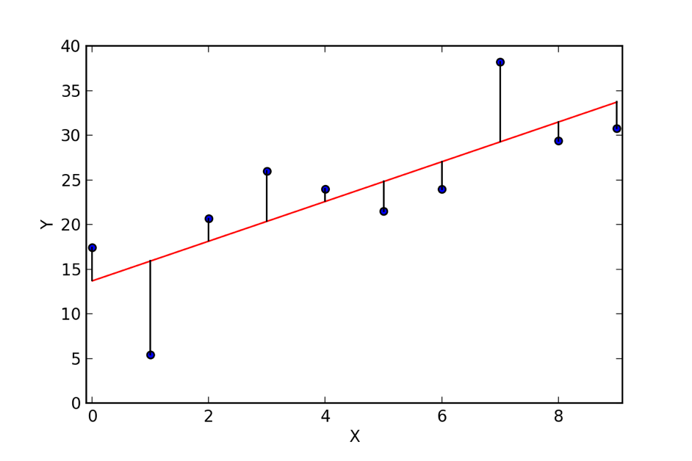
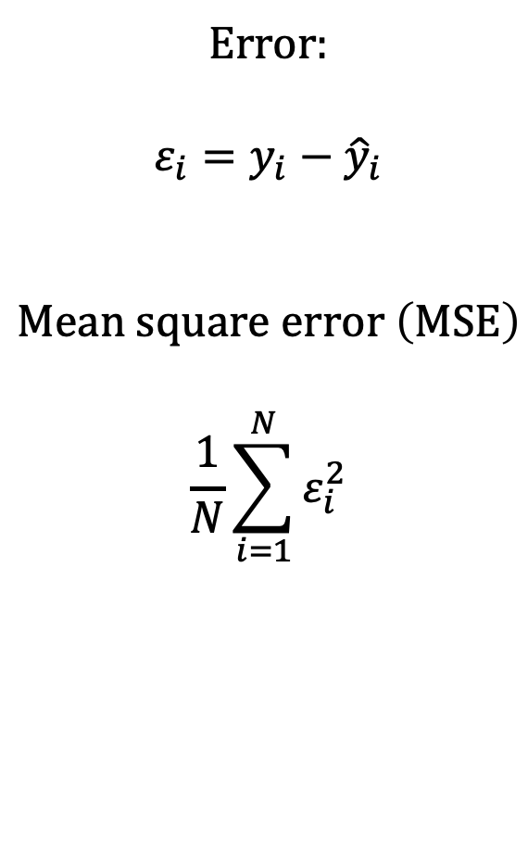
In linear regression, the loss is the mean squared error.
𝜀₈
Error:
$$ε_{i}=y_{i}−{\hat{y}}_{i}$$
$$Mean square error \left(MSE\right)$$
$$\frac{1}{N}\sum_{i=1}^{N}{ε_{i}^{2}}$$
𝜀₁₀
𝜀₉
𝜀₇
𝜀₄
𝜀₅
𝜀₆
𝜀₃
𝜀₁
𝜀₂
Notes:
Now you may remember that in linear regression, you’re trying to minimize the mean squared error
The error is simply the distance between each observed value and the model’s prediction for that value
We square all those errors and take their average – that’s the mean squared error
And, it also happens to be the loss for linear regression.
So we’re looking for parameters that minimize the mean squared error – our loss for this problem
And as it turns out, for linear regression specifically this can be done with some clever matrix multiplication
But for logistic regression, and the models we’ll be talking about, it’s a bit more difficult to find those “best” parameters

Slide 4
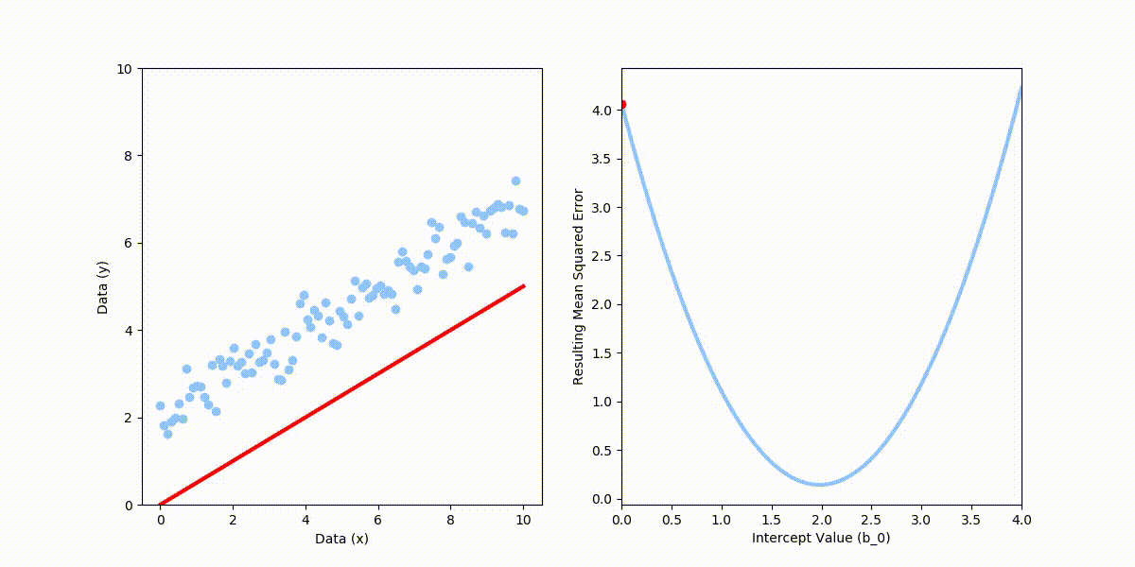
We have two parameters: the slope, and the intercept. As we change the intercept, we can see that the MSE changes. We’re looking for values that minimize it.
Notes:
Let’s take a closer look at finding the best parameters for linear regression with a single predictor, which we can see on the x axis here in the left panel
For now, let’s assume we know what the slope should be, and we’re just trying to find the “best” intercept
As we move the intercept, the loss changes, as shown in the diagram
And when the line describes the data points well – meaning that values predicted by the line are close to the true, observed values of y –
We can see that the mean squared error, shown on the right, is minimized.
The minimizer – the intercept value associated with the lowest mean squared error – that’s the value we’re looking for – it minimizes the loss, and in that sense, it’s the best value

Slide 5
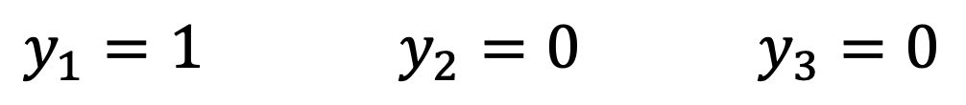
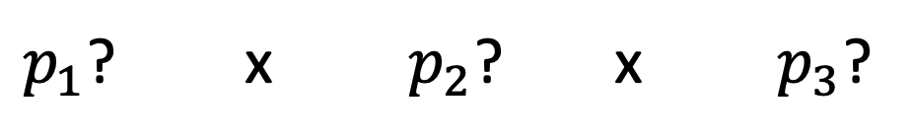
What loss makes sense for logistic regression?
Our model predicts the probability of death for each patient.
If we change the parameters, we change the predicted probabilities for each patient.
$y_{1}=1$ $y_{2}=0$ $y_{3}=0$
(dies) (survives) (survives)
$p_{1}$? x $p_{2}$? x $p_{3}$?
Notes:
Now there’s actually a lot that could be said about why it’s a good idea to use the mean squared error as our loss for linear regression
But at the same time, it’s pretty straightforward to see that this value being low corresponds pretty well with our idea of the line being a “good fit”
For logistic regression, on the other hand, we’re going to need to think a little bit harder about what value would make sense to use as our loss
To do this, let’s go back to an example we’ve considered before: prediction of mortality in the ICU.
Remember, our model takes some measurements about the patient and predicts their risk of dying during their stay.
To keep things simple, let’s consider three patients – the first one dies, the second one lives, and the third also lives
This is our training set, or at least a portion of it.
For each of these patients, our model takes the initial measurements for those patients as its input, and it spits out a prediction about the probability that they will die
And if we change the parameters of our model – the coefficients associated with each measurement – that’s going to change the predicted probabilities that it spits out for all three of the patients.
Again, we’re making predictions about p1, p2, and p3 – the probability that each of those patients will die during their stay -- and changing any model parameter will change all 3 of those predictions.

Slide 6
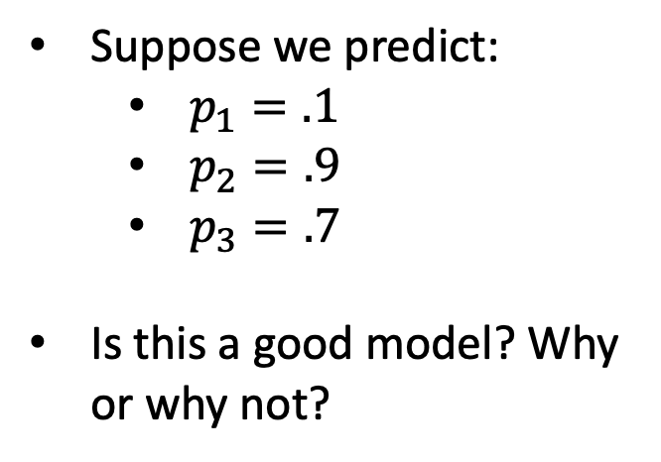
What loss makes sense for logistic regression?
Suppose we predict:
$p_{1}=.1$
$p_{2}=.9$
$p_{3}=.7$
Is this a good model? Why or why not?
$y_{1}=1$ $y_{2}=0$ $y_{3}=0$
(dies) (survives) (survives)
$p_{1}$? x $p_{2}$? x $p_{3}$?
Notes:
Now just like in linear regression, we’re trying to decide what makes a set of predictions “good” or not good
And that decision has to be based on the outcomes that were actually observed. The predictions have to be consistent with the outcomes in some sense, on average.
Let’s consider a set of specific predictions and consider whether they’re consistent with the outcome
We’ll suppose we predict that p1 is .1
P2 is .9
And p3 is .7
Well, the first patient died and the second two survived
And these predictions – well, we’ve predicted a low probability of death for the patient that actually died, and much higher probability of death for the two patients that actually survived.
It is certainly possible that the first patient could have died despite there only being at 10% risk of death.
But across all three patients, it seems like our predictions aren’t very well aligned with the outcomes that we actually observed.
Specifically, supposing these predictions were correct, we might ask: what was the probability that what actually happened was going to happen?
In other words, what was the probability of those three observed outcomes given the predictions made by our model?
Well, the model predicted that patient 1 had a 10% chance of dying – so the probability of the observed outcome was 10% for that patient
It’s also predicting that Patient 2 had a 90% chance of dying – so, the probability of the observed outcome, not dying , was again 10%
And patient 3 had a 70% chance of dying, so the probability of the observed outcome was 30%
So all in all, if we suppose the model’s predictions accurately reflect the reality of the situation, then the observed outcomes were quite unlikely – 10% * 10% * 30% is pretty small

Slide 7
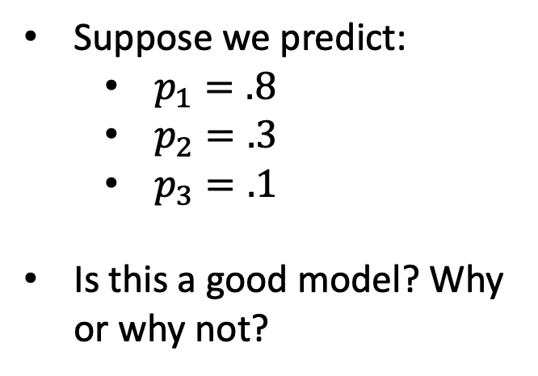
What loss makes sense for logistic regression?
Suppose we predict:
$p_{1}=.8$
$p_{2}=.3$
$p_{3}=.1$
Is this a good model? Why or why not?
$y_{1}=1$ $y_{2}=0$ $y_{3}=0$
(dies) (survives) (survives)
$p_{1}$? x $p_{2}$? x $p_{3}$?
Notes:
Now let’s consider a different set of parameters
We change the parameters of our model, and now it gives us a new set of predictions for each patient.
Let’s do the same thing again – let’s consider whether these new predictions are aligned with what actually happened
Supposing these predictions were correct, what was the probability of the three observed outcomes?
This time, the model predicts that patient 1 was 80% likely to die, which they did – the probability of that outcome was 80%
It also tells us patient 2 was 30% likely to die, therefore 70% likely to live, which they did – the probability of that outcome was 70%
And along the same lines, the probability of the observed outcome for patient 3 was 90%
So, the chance of the observed outcomes as a whole, given the model, is now 80% for patient 1, times 70% for patient 2, times 90% for patient 3
That’s a lot bigger than the 10% * 10% * 30% we had before
So, it seems like this new set of parameters is better than the ones we had before
The model’s predictions now align much better with what ended up happening
Said more precisely, given this set of parameters, the probability of the observed outcomes was much higher.

Slide 8
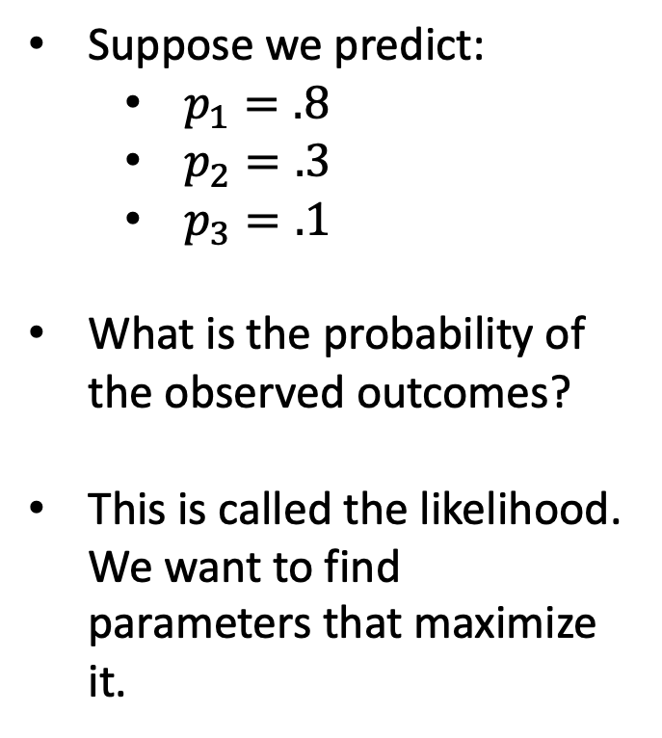
What loss makes sense for logistic regression?
Suppose we predict:
$p_{1}=.8$
$p_{2}=.3$
$p_{3}=.1$
What is the probability of the observed outcomes?
This is called the likelihood. We want to find parameters that maximize it.
$y_{1}=1$ $y_{2}=0$ $y_{3}=0$
(dies) (survives) (survives)
$p_{1}$? x $p_{2}$? x $p_{3}$?
Notes:
So again, what we’re measuring here is just this:
What’s the probability of the observed outcomes given the current model predictions, which are determined by the parameters
More concisely, what’s the probability of the observed outcomes given the current parameter values
This value is called the likelihood. The better aligned our predictors are with the outcomes, the more it increases.
And in fact, the maximum value it could conceivably be is 1 – if we somehow predicted that patient 1 was 100% likely to die, patient 2 was 100% likely to live, and patient 3 was 100% likely to live, then the probability of the observed outcomes given our model is 100%
But something seems wrong with this… such a model really isn’t acknowledging the fact that there’s randomness in these outcomes.
Such a model seems like it’s TOO tuned to the outcomes – in other words, it’s overfitted. And such a model probably would not be likely to generalize well to new data.

Slide 9
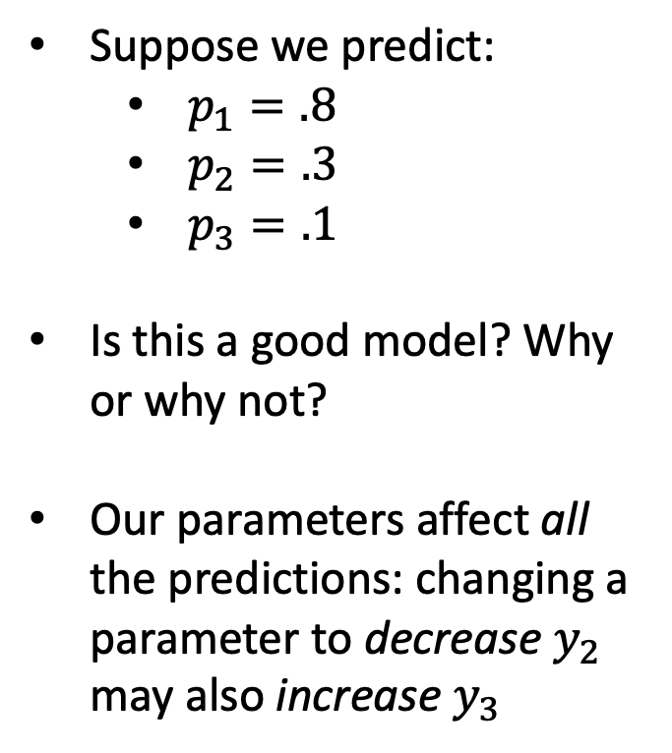
What loss makes sense for logistic regression?
Suppose we predict:
$p_{1}=.8$
$p_{2}=.3$
$p_{3}=.1$
Is this a good model? Why or why not?
Our parameters affect all the predictions: changing a parameter to decrease $y_{2}$ may also increase $y_{3}$
$y_{1}=1$ $y_{2}=0$ $y_{3}=0$
(dies) (survives) (survives)
$p_{1}$? x $p_{2}$? x $p_{3}$?
Notes:
Fortunately, most models aren’t able to overfit in this way.
When we change a parameter, it’s going to affect predictions for all individuals, not just one of them
So, we might want to make the predicted value of p2 lower to bring it more in line with the observed outcome
But, changing a parameter to decrease the prediction for p2 might also increase the predicted value for p3, for instance
We want values that maximize the likelihood across the whole training set
In other words, the parameters that make the predictions align best with the observed outcomes on average

Slide 10
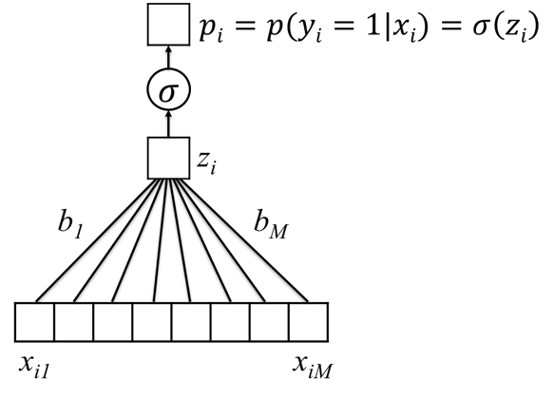
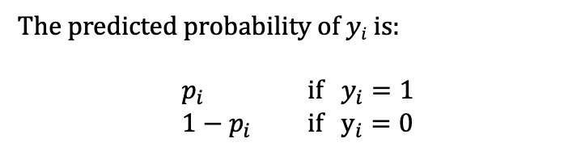
Logistic Regression Likelihood
Probability of all the events $y1,…,yN$given our current model parameters
The predicted probability of $yi$ is:
$p_{i}$ if $y_{i}=1$
$1−p_{i}$ if $y_{i}=0$
Notes:
Now, let’s go back to our logistic regression model and relate our discussion to the equations we’ve discussed
In logistic regression, we have predictors x
We take the dot product of x and the vector b of parameters
Then we add our bias parameter, which gives us z
So far, we have a linear function of the x-es
Then we squash the value z to a valid probability by passing it through the logistic function, indicated here with sigma
And that gives us our predicted probability – the predicted probability that the outcome y is 1
Now, so far we’ve been thinking in terms of the probability that y is 1
We can do this because y can only be 1 or 0
And if y is 1 with probability p, then y must NOT be 1 – y must be 0 – with probability 1 – p
This can be written as shown on the right hand of the slide
Our model predicts that y is 1 with probability p
And that y is 0 with probability 1 - p

Slide 11
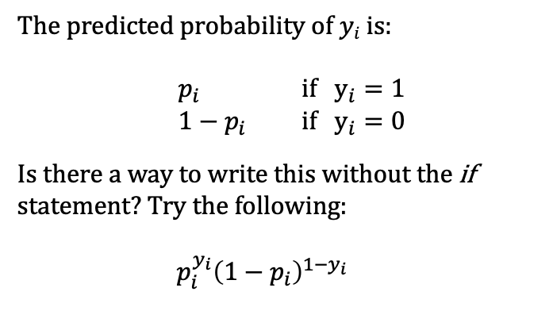
Logistic Regression Likelihood
Probability of all the events $y1,…,yN$given our current model parameters
The predicted probability of $yi$ is:
$p_{i}$ if $y_{i}=1$
$1−p_{i}$ if $y_{i}=0$
Is there a way to write this without the if statement? Try the following:
$p_{i}^{y_{i}}{\left(1−p_{i}\right)}^{1−y_{i}}$
Notes:
Let’s try to work toward a nice, concise mathematical expression for the likelihood.
And the first thing we want to do is to get rid of that if statement in our expression for the probability of y
We can do that with the expression you now see
If you plug in y = 1, you get p – take a moment to verify this
And if you plug in y = 0, you get 1-p – again, take a moment to think this through
This expression tells us, given our model, the probability of the observed outcome, whichever outcome it happened to be – 0 or 1 – for a single patient

Slide 12
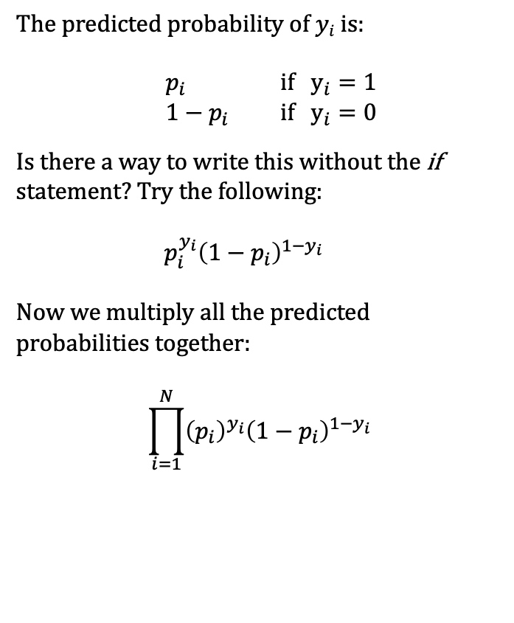
Logistic Regression Likelihood
Probability of all the events $y1,…,yN$given our current model parameters
The predicted probability of $yi$ is:
$p_{i}$ if $y_{i}=1$
$1−p_{i}$ if $y_{i}=0$
Is there a way to write this without the if statement? Try the following:
$p_{i}^{y_{i}}{\left(1−p_{i}\right)}^{1−y_{i}}$
Now we multiply all the predicted probabilities together:
$$\prod_{i=1}^{N}{{\left(p_{i}\right)}^{y_{i}}{\left(1−p_{i}\right)}^{1−y_{i}}}$$
Notes:
But we’re interested in the dataset as a whole, not just a single patient
If we want to look at the probability of all the observed outcomes across our training set,
We have to multiply all those individual predicted probabilities together
That’s exactly what is written here – a product of the predicted probabilities for each of the N patients in our training set

Slide 13
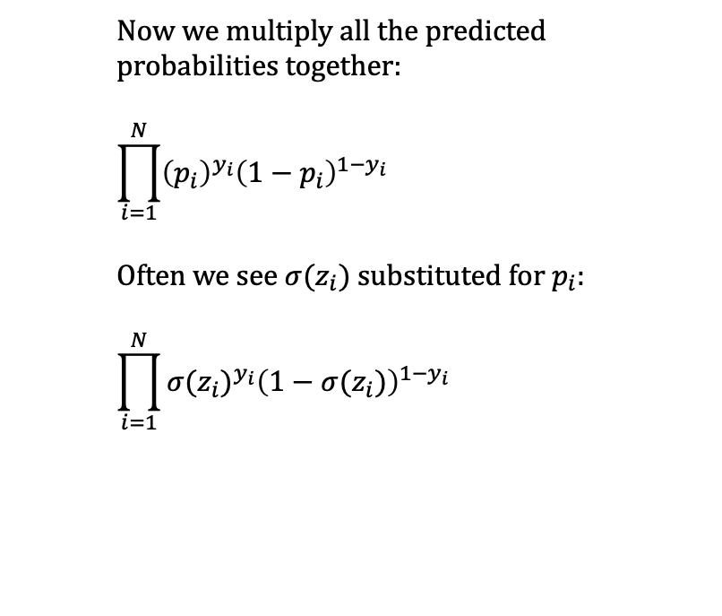
Logistic Regression Likelihood
Probability of all the events $y1,…,yN$given our current model parameters
Now we multiply all the predicted probabilities together:
$$\prod_{i=1}^{N}{{\left(p_{i}\right)}^{y_{i}}{\left(1−p_{i}\right)}^{1−y_{i}}}$$
Often we see $σ(z_{i})$substituted for $p_{i}$:
$$\prod_{i=1}^{N}{{σ(z_{i})}^{y_{i}}{\left(1−σ(z_{i})\right)}^{1−y_{i}}}$$
Notes:
Most commonly this is written in terms of z rather than p – and as we know, p is just equal to the logistic function applied to z
We’re almost there, just one more modification and we’re done.

Slide 14
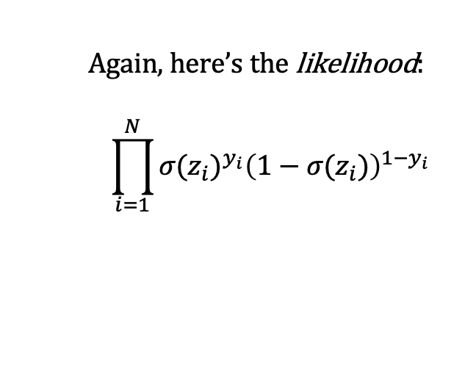
Two Final Modifications
Again, here’s the likelihood:
$$\prod_{i=1}^{N}{{σ(z_{i})}^{y_{i}}{\left(1−σ(z_{i})\right)}^{1−y_{i}}}$$
Notes:
This expression here is the likelihood -- the probability of the observed outcomes given our current model.
So, increasing it means that our predictions are better aligned with our observations
But remember, we said before that by convention, we want to find a numeric value that we can minimize
In linear regression, this was the mean squared error.
So we’re going to make just a couple more minor modifications that will help us get a value that’ll be convenient to work with during the learning process

Slide 15
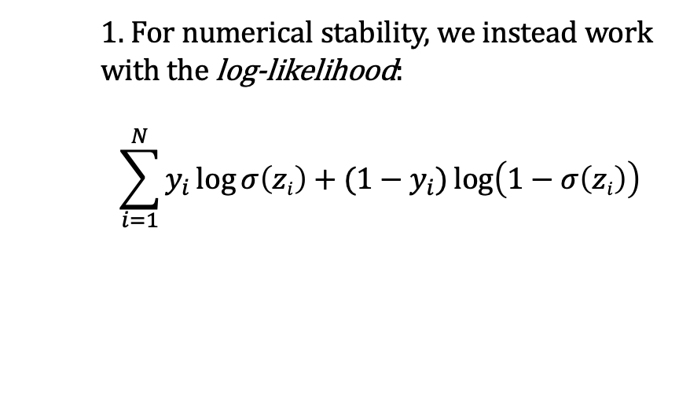
Two Final Modifications
Again, here’s the likelihood:
$$\prod_{i=1}^{N}{{σ(z_{i})}^{y_{i}}{\left(1−σ(z_{i})\right)}^{1−y_{i}}}$$
1. For numerical stability, we instead work with the log-likelihood:
$$\sum_{i=1}^{N}{y_{i}\log{σ\left(zi\right)}+(1−y_{i})\log\left(1−σ\left(zi\right)\right)}$$
Notes:
First, the thing is, when we multiply a large number of values together and all those values are less than 1, we get a really small value
Too small for a computer to work with, in many cases
So, to make sure these values don’t get to small for our computer
We’re going to work on a log scale
And when we take the log of this expression, we can apply some rules of logarithms to make a few additional simplifications
Specifically, we’re using two properties here
The first is that the logarithm of the product of terms is equal to the sum of the logarithm of the terms
The second along the same lines, we can pull those exponents outside of the logarithm, where they become products
This is straightforward if you review properties of logarithms
And since the logarithm of a value always increases as a value increases, the parameters that maximize the likelihood will also maximize the log-likelihood, and vice versa

Slide 16
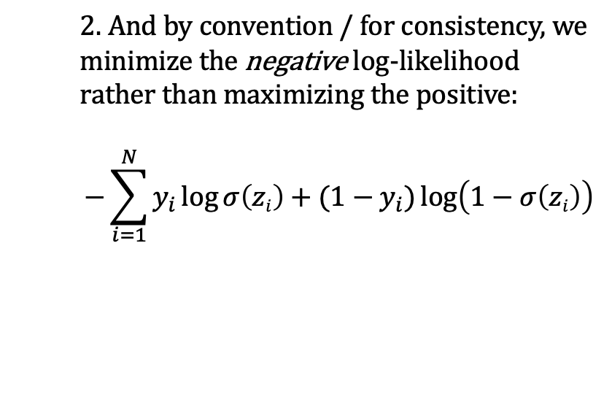
Two Final Modifications
Again, here’s the likelihood:
$$\prod_{i=1}^{N}{{σ(z_{i})}^{y_{i}}{\left(1−σ(z_{i})\right)}^{1−y_{i}}}$$
1. For numerical stability, we instead work with the log-likelihood:
$$\sum_{i=1}^{N}{y_{i}\log{σ\left(zi\right)}+(1−y_{i})\log\left(1−σ\left(zi\right)\right)}$$
2. And by convention / for consistency, we minimize the negative log-likelihood rather than maximizing the positive:
$$−\sum_{i=1}^{N}{y_{i}\log{σ\left(zi\right)}+(1−y_{i})\log\left(1−σ\left(zi\right)\right)}$$
Notes:
Finally, by convention, as mentioned before
We’re going to minimize the negative log likelihood instead of maximizing the likelihood
So, we multiply that previous expression by negative 1 and we’re done – this is our loss
It’s called the cross-entropy loss, and is also the negative log-likelihood corresponding to our logistic regression model
Importantly, for those of you who are exhausted by this point
We’ll use this same loss for the multilayer perceptron
And for computer vision
And for natural language processing
In fact, we’ll use it for any binary classification task
And we’ll use a very simple extension of this for classification tasks with more that two outcomes – in other words, multi-class problems

Slide 17
Cross-Entropy Loss
Again, here’s the likelihood:
$$\prod_{i=1}^{N}{{σ(z_{i})}^{y_{i}}{\left(1−σ(z_{i})\right)}^{1−y_{i}}}$$
1. For numerical stability, we instead work with the log-likelihood:
$$\sum_{i=1}^{N}{y_{i}\log{σ\left(zi\right)}+(1−y_{i})\log\left(1−σ\left(zi\right)\right)}$$
2. And by convention / for consistency, we minimize the negative log-likelihood rather than maximizing the positive:
$$−\sum_{i=1}^{N}{y_{i}\log{σ\left(zi\right)}+(1−y_{i})\log\left(1−σ\left(zi\right)\right)}$$
This is called the cross-entropy loss.
We are looking for parameters that make it as small as possible.
It is used for all the prediction tasks we consider in this course.
Notes:
Here’s what it looks like graphically.
If the outcome is zero for a given patient, the cross entropy loss is 0 for a predicted value of zero
As the predicted value approaches 1, the loss becomes infinitely large
What this means, practically, is that when training our models, they are forced to avoid predicting values very close to 1 when the outcome is zero, and vice versa
And the situation is symmetric – if the outcome is 1 for a given patient, the cross entropy loss is 0 for a predicted value of 1 and becomes infinitely large for predicted values approaching 0
Again, we’re looking for parameters that make this value as small as possible, on average, across all individuals in the training set.

Slide 18
How do we minimize the loss?
The cross-entropy loss just tells us what quantity we should be minimizing
In some cases (e.g. linear regression), we can solve for the minimum directly
But, we’d like to have an approach that works even for very complex models
Notes:
At this point, we’re about halfway done:
We know what quantity we ought to be minimizing, but we’re not sure how to actually get there.
We need a strategy for finding parameters that actually minimize this value – or at least, a strategy for reducing it

Slide 19
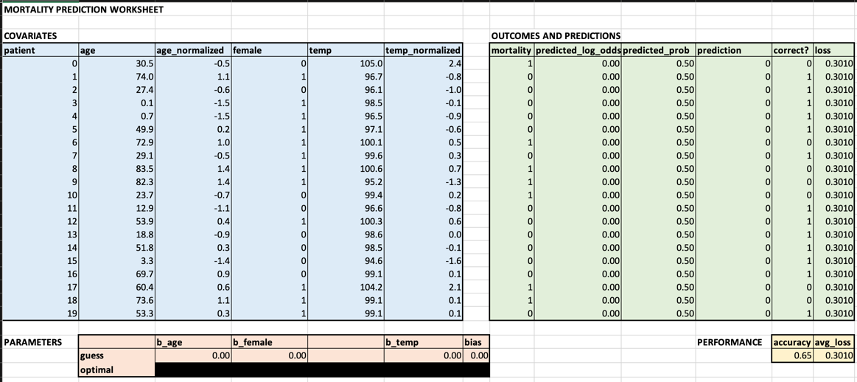
Strategy: determine how small changes in parameters affect the loss
Notes:
One thing we could try is to just test out a bunch of different sets of parameter values
Then we can just choose the set associated with the smallest value of the loss
Or we could play around with different parameter values
And see if we can reduce the loss a little by making changes to them
We might try to figure out, through exploration, how changing specific parameters affects the loss
This is what you’ll explore in your exercise

Slide 20
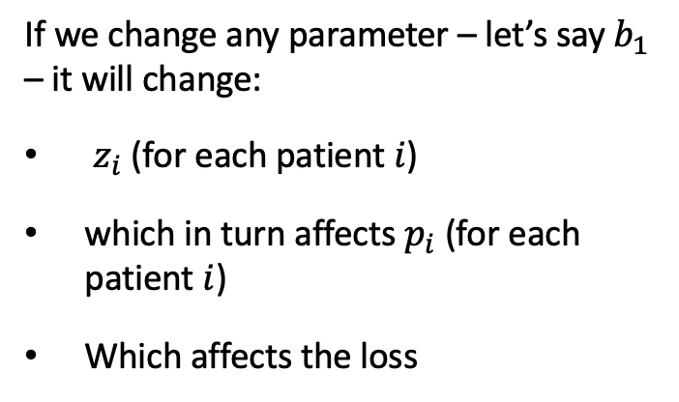
How does changing a parameter change the loss?
If we change any parameter – let’s say $b_{1}$ – it will change:
$z_{i}$ (for each patient $i$)
which in turn affects $p_{i}$ (for each patient $i$)
Which affects the loss
Notes:
But to really do this effectively, and consistently, we need to have a systematic way of understanding how changing each model parameter affects the loss
If we understand that relationship, we can use it to tweak those parameter values
So let’s start to think about that relationship.
In our logistic regression model, if we change a single parameter – let’s say b_1
How will that change the loss?
Well, changing b_1 affects z -- take a moment to consider how much a specific change to b_1 will change z
And then that change in z in turn affects the predicted probability p
And as we know, p is found in the expression for the loss

Slide 21
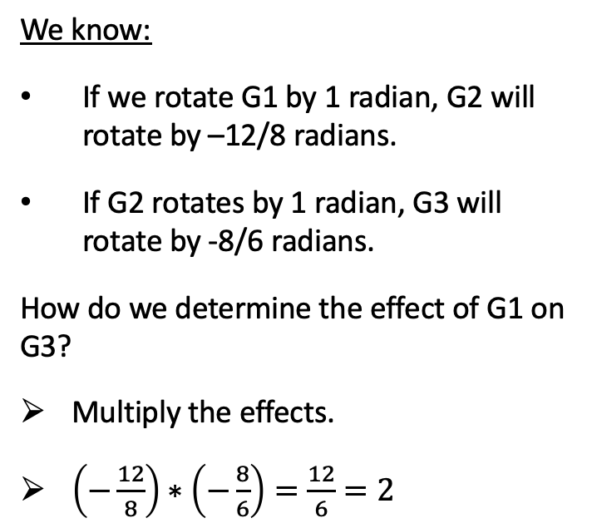
A chain of effects…
We know:
If we rotate G1 by 1 radian, G2 will rotate by –12/8 radians.
If G2 rotates by 1 radian, G3 will rotate by -8/6 radians.
How do we determine the effect of G1 on G3?
Multiply the effects.
$\left(−\frac{12}{8}\right)∗\left(−\frac{8}{6}\right)=\frac{12}{6}=2$
G1
G2
G3
Notes:
So we have a chain of effects – one value affects another, which in turn affects another
And, much like a chain of gears, the effects multiply
If we know much a little movement of gear 1 moves gear 2, and we know how much a little movement of gear 2 affects gear 3
We can multiply those effects together to figure out how much a little movement of gear 1 moves gear 3

Slide 22
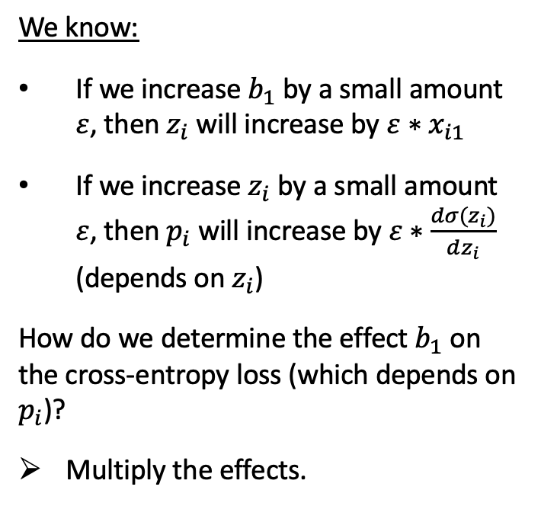
A chain of effects…
We know:
If we increase $b_{1}$ by a small amount $ε$, then $z_{i}$ will increase by $ε∗x_{i1}$
If we increase $z_{i}$ by a small amount $ε$, then $p_{i}$ will increase by $ε∗\frac{dσ(z_{i})}{dz_{i}}$ (depends on $z_{i}$)
How do we determine the effect $b_{1}$ on the cross-entropy loss (which depends on $p_{i}$)?
Multiply the effects.
Notes:
It’s the same in our model.
If we know how much a little change in b_1 changes z, and we know how much a little change in z changes p – and finally, how much a little change in p affects the loss -- then we can multiply those effects together to determine how much a little change in b_1 changes the loss

Slide 23
Our strategy: use principles of calculus – slope/gradient – to determine how small changes in parameters affect the loss
We use the chain rule (calc 101) to account for the chain of effects.
Could be a very long chain…
Some parameters have a greater effect than others
We change all parameters at once, with each change proportional to that parameter’s effect on the loss
This is gradient descent
Notes:
This is in fact the chain rule, which you might remember from calculus
If we break down the problem into pieces – the effect of b1 on z, the effect of z on p, and so on
It’s very easy to figure out all those rates of change – it’s just a simple derivative
And we can multiply all those individual rates of change together to determine the effect of changing a single parameter on far away points within our graph

Slide 24
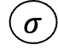
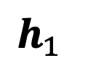
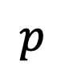
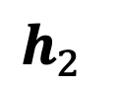
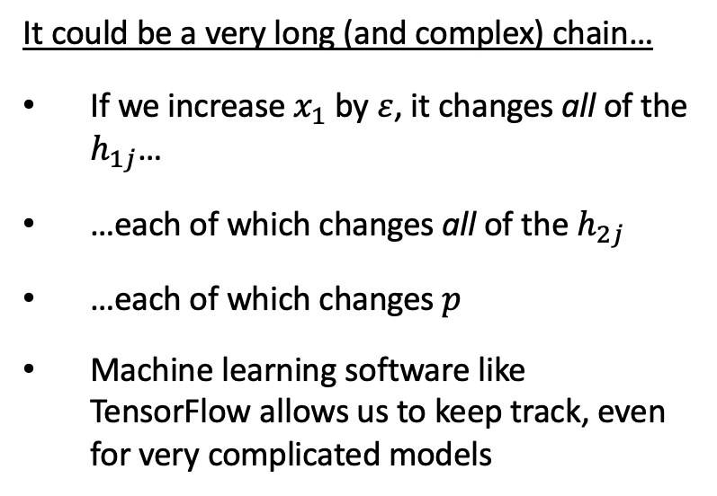
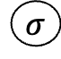
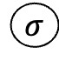
Our strategy: use principles of calculus – slope/gradient – to determine how small changes in parameters affect the loss
$$p$$
It could be a very long (and complex) chain…
If we increase $x_{1}$ by $ε$, it changes all of the $h_{1j}$…
…each of which changes all of the $h_{2j}$
…each of which changes $p$
Machine learning software like TensorFlow allows us to keep track, even for very complicated models
$$σ$$
$h_{2}$
$$σ$$
$h_{1}$
$$σ$$
x
Notes:
For more complicated models, the number of effects we’ll need to calculate becomes much larger
And we have to keep track of multiple pathways along which changing a single parameter can have an effect
If we change a parameter in the first layer, it might only affect a single value in the second layer
But, that change will in turn affect all values in subsequent layers
Still, by breaking this problem down into a large number of simple problems…
And applying our chain rule
We can quantify the effect of changing each parameter in our model on the loss
This process – this specific way of using the chain rule – is called backpropagation.
Using this approach, we might find, for example, that decreasing b_1 by a small amount will rapidly increase the loss, whereas increasing b_1 by a small amount will rapidly decrease the loss. This information suggests that we should try increasing b_1 by a little bit.
We can then re-examine the situation. It could be that increasing b_1 a little more will continue to decrease the loss.
Or it could be that the situation has changed – we now find that increasing b_1 no longer affects the loss in either direction.
This suggests we’ve probably found a good value of b_1.

Slide 25
For simple models, minimizing the loss is easy.
There are a limited number of parameters to consider
Here, the loss is ‘bowl-shaped’, or convex; we can simply walk downhill from our current position
For linear regression, we can simply solve for the best parameters; but in general this is not true
Notes:
Even for simple models, just because moving a parameter in one direction lowers the loss, it doesn’t mean we should move the parameter in that direction indefinitely
The relationship between changes in the parameter and the change in the loss depends on the current value of the parameter.
For simple models, however – and this includes logistic regression – we do have an important advantage, one that is illustrated here
Namely, the relationship between model parameters and the loss is bowl-shaped
This is very important, because it tells us that if we find a configuration of the parameters that’s better than all the alternative configurations in its immediate vicinity –
In other words, if we apply backpropagation, and it tells us that changing any of our parameters in either direction won't decrease the loss
Then we know we’re at the bottom of the bowl
And we’ve found the best possible configuration of our parameters

Slide 26


For complex models, it is much more difficult…
High-dimensional
Non-convex
No closed-form solution
Notes:
In contrast, for deep learning models, the relationship between the parameters and the loss does not look like a bowl…
It looks more like a mountain range.
Backpropagation tells us which way is downhill – it gives us the gradient, which tells us which way we should walk if we want to go uphill – or, if we walk in the opposite direction, downhill – as quickly as possible.
But it’s possible to find ourselves in a valley – backpropagation tells us that no matter which way we walk, the loss – the altitude in this analogy – won't decrease
And yet this does not necessarily mean we’re in the best valley
There could be another valley, one we haven’t yet come across, for which the loss – the altitude – is lower.
Unfortunately, we have no way to get there.

Slide 27
…and we’re never sure we’ve found the best parameters
Notes:
Remember, we’re considering models with a very large number of parameters
So, there are many more than two directions in which we can move – in some cases, there might be many thousands of parameters we have to consider adjusting.

Slide 28


Learning in Neural Networks
With deep learning models, we are trying to minimize a function of many variables
Can’t visualize it
Can’t solve for the minimum directly
So, we follow the slope and hope for the best (i.e. gradient descent)
May end up in a low point that isn’t the lowest, i.e. local minimum
But, if we have lots of data, things usually work out OK
Notes:
We cannot visualize the relationship between the parameters and loss – there are too many possible directions to consider
The best we can do is ask backpropagation:
Which way is downhill?
Then we move in that direction for a bit and ask again.
When we find ourselves in a valley – that’s when we stop, and fix the parameters to their current values – our learning process is complete
The amazing thing, though, is that this works surprisingly well in practice even for datasets of moderate size
The breast cancer dataset is an excellent example of this
Despite there being no guarantee that our neural network will work well, in practice, it tends to find good solutions – parameter configurations with low loss, and that also generalize well.

Slide 29
Conclusions
Learning consists in setting model parameters to maximize some measure of fit; or equivalently, minimize some loss
In classification problems, the loss we wish to minimize is called the cross-entropy loss, and it related to the probability of the observed outcomes supposing our current model were correct
Backpropagation allows us to determine how the loss is affected by small changes in each model parameter. We can apply this information repeatedly to reduce the loss.
In deep learning, we can never be sure that we’ve found the best possible parameters, but in practice, we find good parameter values that generalize well
Notes:
Thanks for listening, and see you in the next lecture.

